Slide 1
DATA 366-Introduction to Multivariate Statics
Foundations of Multivariate Statistics
By
Dr. Zakir

Slide 2
Outlines
Introduction to Multivariate Statistics/Analysis
Data Organization for multivariate analysis
Exploring Multivariate Data
Descriptive Statistics Approaches
Graphical Approaches
Statistical Distance

Slide 3
Introduction to Multivariate Statistics
Multivariate statistics deal with the analysis of data sets involving more than two variables.
It’s a set of statistical techniques used to analyze/interpret data that contains more than two variable.
Designed to understand the complex relationships and interactions among multiple variables.
Notes:
Factor analysis identifies unobserved underlying variables, or "factors," that explain the correlation patterns among a large set of observed variables.
Its primary goals are to reduce the dimensionality of complex datasets, simplify them into a smaller set of factors, and uncover the underlying theoretical structure or constructs within the data, making complex relationships more interpretable
ANOVA, or Analysis of Variance, is a statistical method used to compare the means of two or more independent groups to see if their differences are statistically significant.

Slide 4
Multivariate Statistics Techniques
Multiple regression
MANOVA (Multivariate ANOVA)
PCA (Principal Component Analysis)
Cluster analysis
Factor analysis
Notes:
Factor analysis identifies unobserved underlying variables, or "factors," that explain the correlation patterns among a large set of observed variables.
Its primary goals are to reduce the dimensionality of complex datasets, simplify them into a smaller set of factors, and uncover the underlying theoretical structure or constructs within the data, making complex relationships more interpretable
ANOVA, or Analysis of Variance, is a statistical method used to compare the means of two or more independent groups to see if their differences are statistically significant.

Slide 5
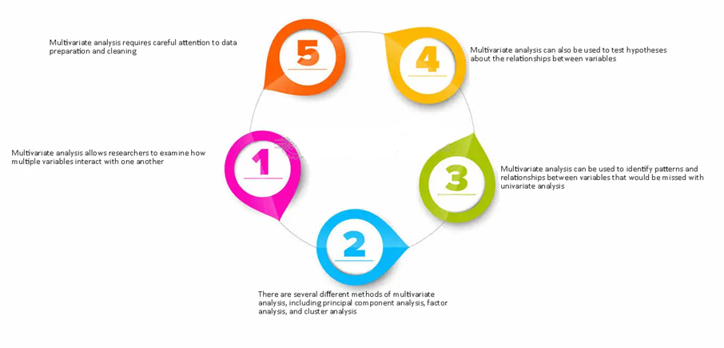
Multivariate Analysis
Multivariate analysis is the application of multivariate techniques to a data set to understand the relationships and structures within the variables.

Slide 6
Levels of Data Analysis
Aspect | Univariate Analysis | Bivariate Analysis | Multivariate Analysis
Number of Variables | One | Two | More than two
Purpose | Describe a single variable | Explore relationships between two variables | Analyze complex interactions among multiple variables
Examples | Mean, Median, Variance, Histogram | Correlation, Scatter Plot, Simple Linear Regression | Multiple Regression, MANOVA, PCA, Cluster Analysis
Relationships Studied | None | Yes, between two variables | Yes, between three or more variables
Complexity | Low | Moderate | High
Limitations | Ignores relationships between variables | Only captures pairwise relationships | Requires advanced methods and interpretation
Use Cases | Descriptive stats, distributions | Effect of one variable on another | Modeling real-world problems involving multiple factors
Notes:
Analysis of Variance (ANOVA) is a statistical formula used to compare variances across the means (or average) of different groups.

Slide 7
Real-world applications
Medical diagnosis: Using patient data (blood pressure, cholesterol, sugar levels, etc.) to classify diseases (e.g., diabetes, heart disease).
Clinical trials: Assessing multiple outcomes (e.g., side effects, effectiveness, recovery time) across treatment groups.
Credit scoring: Using multiple predictors (income, age, credit history) to assess the likelihood of loan default.
Market segmentation: Identifying customer groups based on multiple economic variables (spending habits, income, location, etc.).

Slide 8
Outlines
Introduction to Multivariate Statistics/Analysis
Data Organization for multivariate analysis
Exploring Multivariate Data
Descriptive Statistics Approaches
Graphical Approaches
Statistical Distance

Slide 9
Data Organization
Data organization refers to structuring, arranging, and preparing data so that it can be meaningfully analyzed using multivariate statistical techniques.
Multivariate analysis requires careful attention to cleaning, structuring, transforming and standardizing datasets
Missing data and outliers can skew the results of the analysis.
The standard and most common way to organize multivariate data is as a data matrix or table.

Slide 10
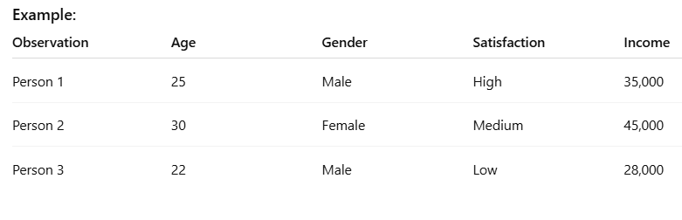
Data Matrix
A structured way to organize data, where rows represent observations, columns represent variables or features.

Slide 11
Variable Types Clearly Defined
Each column should be clearly labeled with:
A meaningful variable name
A consistent measurement scale:
Nominal
Ordinal
Interval
Ratio

Slide 12
Measurement Scales
Variables can be measured using different scales, which affect how we analyze the data. These scales are:
1. Nominal Scale (Qualitative / Categorical)
Definition: Categories with no inherent order.
Examples:
Gender (Male, Female)
Eye color (Blue, Green, Brown)
Country (USA, India, Germany)
Operations Allowed: = (equal), ≠ (not equal)
Can’t say one category is more or less than another.

Slide 13
Measurement Scales
2. Ordinal Scale
Definition: Categories with a meaningful order, but no consistent difference between them.
Examples:
Satisfaction (Low, Medium, High)
Education level (High School, Bachelor, Master)
Operations Allowed: =, ≠, <, >
Cannot perform mathematical operations like subtraction.

Slide 14
Measurement Scales
3.Interval Scale
Definition: Ordered categories with equal intervals, but no true zero.
Examples:
Temperature in Celsius or Fahrenheit
Dates (e.g., years)
Operations Allowed: +, –, <, >
Cannot say "twice as much" (no absolute zero).

Slide 15
Measurement Scales
4. Ratio Scale
Definition: Ordered, equal intervals with a true zero point.
Examples:
Income
Age
Height, Weight
Operations Allowed: All mathematical operations (+, –, ×, ÷)
Can say "twice as much" makes sense here.

Slide 16
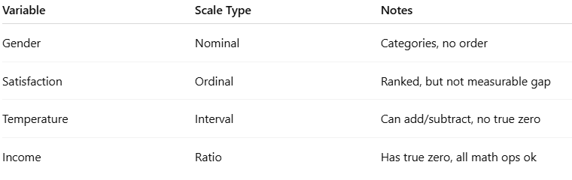
Combining Matrix and Scales
In the data matrix, each column is a variable and has one of the measurement scales above.
The scale type determines:
How the variable can be summarized (mean, median, mode)
What kind of statistical tests can be applied
How you can interpret or visualize the data

Slide 17
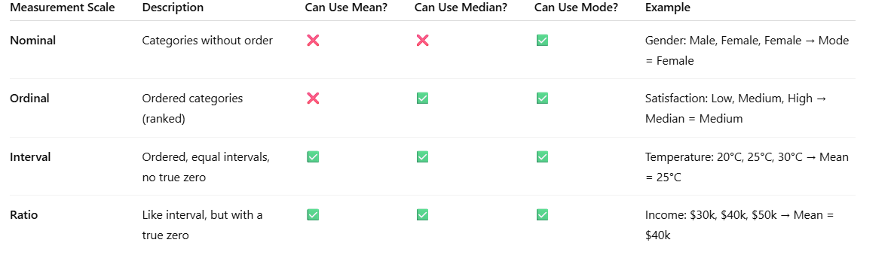
Summarize Variables by Measurement Scale

Slide 18
Outlines
Introduction to Multivariate Statistics/Analysis
Data Organization for multivariate analysis
Exploring Multivariate Data
Descriptive Statistics Approaches
Graphical Approaches
Statistical Distance

Slide 19
Descriptive Statistics
A large dataset with multiple variable makes it difficult to visualize it.
Much of the information contained in the data can be assessed by calculating certain summary numbers, known as descriptive statistics.
Means, variances, covariances, corrélations and Covariance matrix
Notes:
Use datasets with 3–5 variables initially, and show how multivariate methods give insights that univariate or bivariate methods miss.

Slide 20
Graphical Techniques
Although it is impossible to simultaneously plot all the measurements made on several variables and study the configurations.
It is good statistical practice to plot pairs of variables and visually inspect the pattern of association, it can be still very informative. Following are the types of plots for two variables.
Scatterplot matrices
Pairwise plots
Heatmaps
PCA biplots (introductory)
Notes:
Use datasets with 3–5 variables initially, and show how multivariate methods give insights that univariate or bivariate methods miss.

Slide 21
Outlines
Introduction to Multivariate Statistics/Analysis
Data Organization for multivariate analysis
Exploring Multivariate Data
Descriptive Statistics Approaches
Graphical Approaches
Statistical Distance

Slide 22
Statistical Distance
Important concept for quantifying the similarity/dissimilarity
Euclidean distance doesn't account for correlations, multivariate statistical distances (Mahalanobis) account for these factors, providing a more accurate measure of distance in complex, multi-variable data.
Multivariate statistical distances has applications in clustering/classification
Notes:
Use datasets with 3–5 variables initially, and show how multivariate methods give insights that univariate or bivariate methods miss.

